Slide 1

Transportation and Logistics Data Pipeline Industrial Internship at Bizmetric, Pune By Amal A PRN: 1062231053

Slide 2
Introduction
This project focuses on building an automated data pipeline for transportation and logistics using Azure tools as logistics data is fragmented and unstructured.
The objective was to build an automated pipeline to ingest, clean, transform, and visualize real-world logistics data following Medallion Architecture.

Slide 3


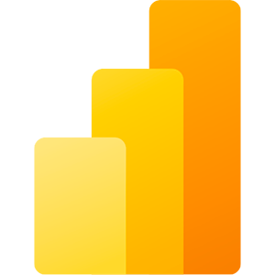

Tools and Technologies used
Cloud and Storage: Azure Blob, ADLS Gen2
Processing: Azure Databricks, PySpark
Database: MySQL
Visualization: Power BI
Orchestration: Azure Data Factory

Slide 4
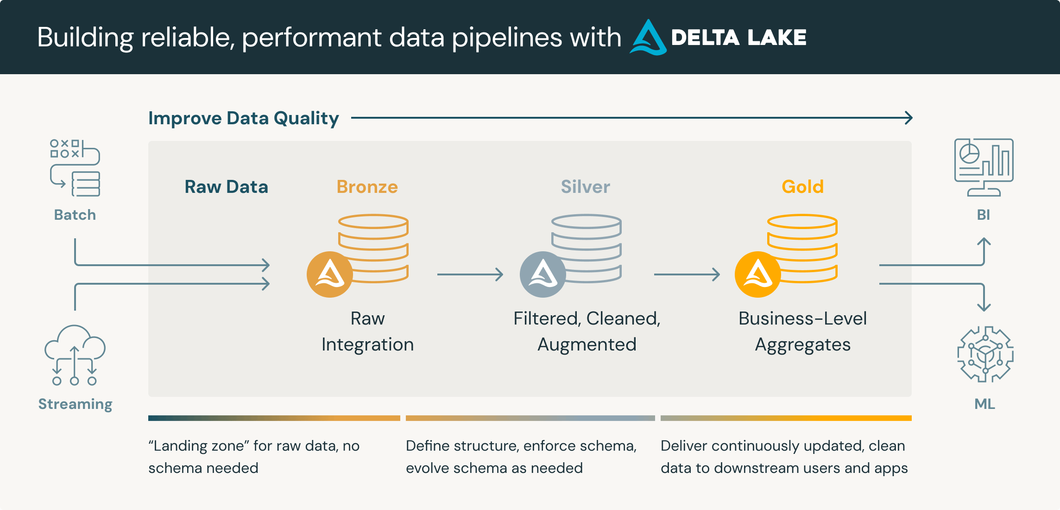
Medallion Architecture
Medallion Architecture is a data design pattern with its core idea being to logically organize data into layers.
Classic Medallion Architecture consists of three layers: bronze, silver, gold. Data is processed, cleaned, and moved between layers using data pipelines.
The quality and structure of data increases from layer to layer.

Slide 5
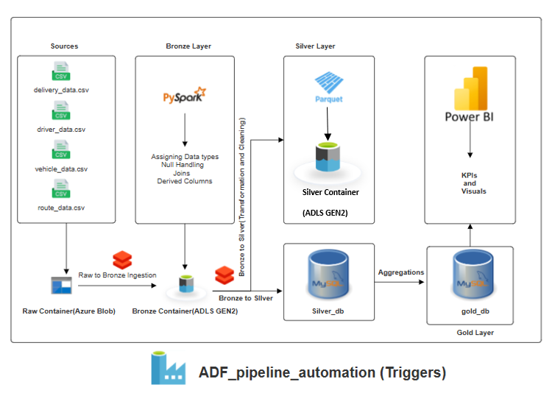
Project Architecture

Slide 6
Data Ingestion
Input: raw source csv files from Azure Blob raw container.
Processed using PySpark in Databricks
Converted to Parquet, stored in ADLS Gen2
Metadata added: timestamp, file name
CSV Files(Raw Data)
PySpark in Azure Databricks
Parquet (Bronze, ADLS GEN2)

Slide 7
Data Cleaning & Transformation
Null Values are handled and data typecasting is carried out.
delivery data is joined with driver, vehicle and route data.
Derived column are added.
Final joined table delivery_data_silver is written to both Silver Container as well as Silver_db.
Parquet File (Bronze, ADLS GEN2)
PySpark Transformations (Cleaning, Enrichment, Derived Columns)
Save as Parquet in ADLS (Silver, ADLS GEN2)
And
Load to MySQL (Silver Tables)

Slide 8
Business Aggregation
SQL aggregation are carried out such as:
Total Deliveries by Route
Avg Delivery Time per Driver
Fuel Consumption per Vehicle
Delivery Status Ratios
Final aggregated table transportation_gold is derived from silver_db into gold_db
Silver Table (in MySQL)
SQL Aggregations
Save table to gold_db in MySQL (transportation_gold)

Slide 9
Power BI Dashboard
A connection to Gold Layer (gold_db, MySQL) is established.
KPIs are derived (Total Deliveries, Avg Delivery Time, Fuel Consumption Rate, Route-wise Delivery Count, Driver Ratings).
Visual are made (Line Chart, Bar Chart, Pie Chart).
Add Filters (Date, Region, Vehicle Type)
Gold Table in MySQL
SQL AggregaMySQL Connector in Power BItions
Dashboard Elements: KPIs (Delivery Count, Avg Time), Charts (Line, Bar, Pie), Filters (Region, Date, Driver)

Slide 10
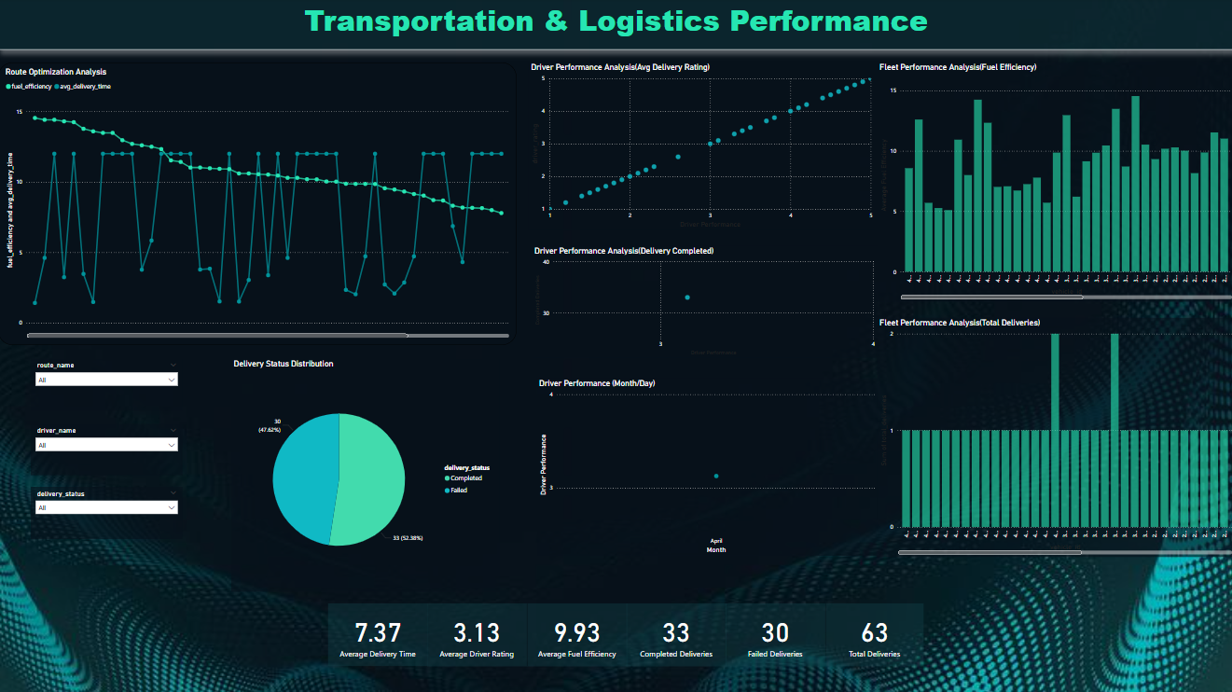
Final Dashboard with KPIs and visuals

Slide 11
Challenges Faced and Learnings
Challenges Faced
MySQL region limitations
Missing SQL Library issues
Power BI connection error
Learnings
Implemented real-world data architecture (Bronze-Silver-Gold)
Built ETL pipeline with PySpark and SQL
Created dashboards with Power BI
Gained cloud automation experience

Slide 12

Thank You

